Slide 1
POLYNOMIAL REGRESSION

Slide 2
INTRODUCTION
Polynomial regression is a kind of linear regression in which the relationship shared between the dependent and independent variables Y and X is modeled as the nth degree of the polynomial. This is done to look for the best way of drawing a line using data points.
In statistics, polynomial regression is a form of regression analysis in which the relationship between the independent variable x and the dependent variable y is modelled as an nth degree polynomial in x.
Although this model allows for a nonlinear relationship between Y and X, polynomial regression is still considered linear regression since it is linear in the regression coefficients.

Slide 3
The equation of the polynomial regression having an nth degree can be written as:
Y= b₀+b₁x+ b₂x²+ b₃x³+...... b_{n}x^{n}
^{Y: Dependent Variable}
X: Independent Variable
_{b1, b2, b3: Coefficients}
_{n: Number of observations}

Slide 4
Need for Polynomial Regression:
The need of Polynomial Regression in ML can be understood in the below points:
If we apply a linear model on a linear dataset, then it provides us a good result as we have seen in Simple Linear Regression, but if we apply the same model without any modification on a non-linear dataset, then it will produce a drastic output. Due to which loss function will increase, the error rate will be high, and accuracy will be decreased.
So for such cases, where data points are arranged in a non-linear fashion, we need the Polynomial Regression model. We can understand it in a better way using the below comparison diagram of the linear dataset and non-linear dataset.

Slide 5
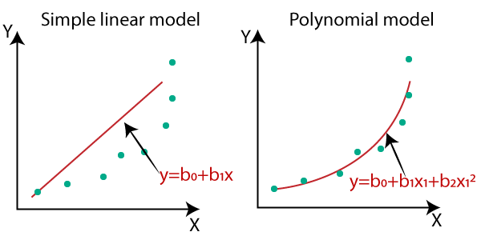
In the above image, we have taken a dataset which is arranged non-linearly. So if we try to cover it with a linear model, then we can clearly see that it hardly covers any data point. On the other hand, a curve is suitable to cover most of the data points, which is of the Polynomial model.
Hence, if the datasets are arranged in a non-linear fashion, then we should use the Polynomial Regression model instead of Simple Linear Regression.

Slide 6
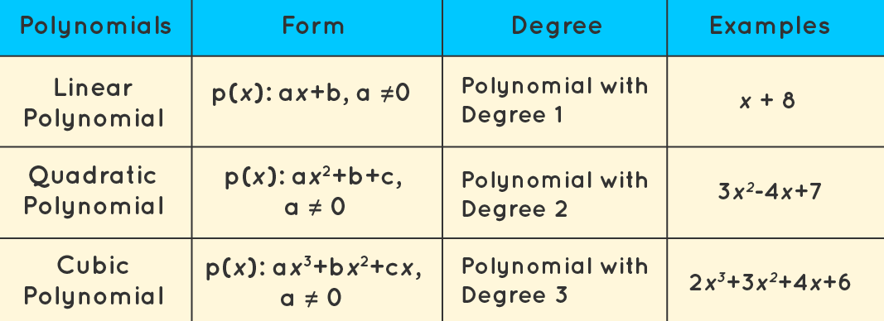
Types of Polynomial Regression:
A quadratic equation is a general term for a second-degree polynomial equation. This degree, on the other hand, can go up to nth values. Polynomial regression can so be categorized as follows:
1. Linear – if degree as 1
2. Quadratic – if degree as 2
3. Cubic – if degree as 3 and goes on, on the basis of degree.

Slide 7
Assumption of Polynomial Regression:
We cannot process all of the datasets and use polynomial regression machine learning to make a better judgment. We can still do it, but there should be specific constraints for the dataset in order to get the best polynomial regression results.
A dependent variable’s behaviour can be described by a linear, or curved, an additive link between the dependent variable and a set of k independent factors.
The independent variables have no relationship with one another.
We’re utilizing datasets with independent errors that are normally distributed with a mean of zero and a constant variance.

Slide 8
Advantages of using Polynomial Regression:
Polynomial provides the best approximation of the relationship between the dependent and independent variable.
A Broad range of function can be fit under it.
Polynomial basically fits a wide range of curvature.

Slide 9
Disadvantages of Polynomial Regression:
One or two outliers in the data might have a significant impact on the nonlinear analysis' outcomes. These are overly reliant on outliers. Furthermore, there are fewer model validation methods for detecting outliers in nonlinear regression than there are for linear regression.

Slide 10
Applications of Polynomial Regression:
It is used to study the isotopes of the sediments.
It is widely applied to predict the spread rate of COVID-19 and other infectious diseases
It is used to study the rise of different diseases within any population.
It is used to study the generation of any synthesis.

Slide 11
Conclusion:
Polynomial Regression is used in many organizations when they identify a nonlinear relationship between the independent and dependent variables. It is one of the difficult regression techniques as compared to other regression methods, so having in-depth knowledge about the approach and algorithm will help you to achieve better results.

Slide 12
THANK YOU

